Slide 1
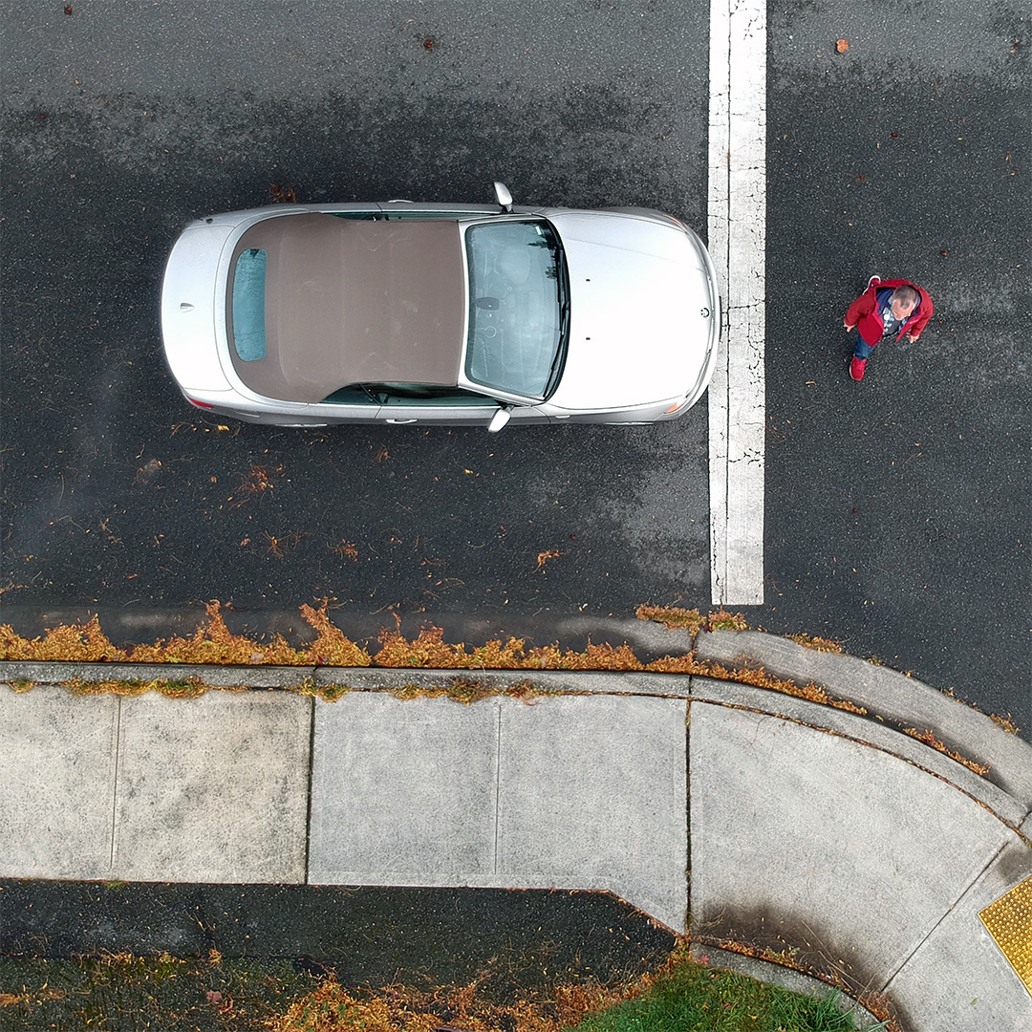

Most of us in Washington agree that we all share responsibility for the safety of others on our roads.*
This is how drivers do it in ________ County:
Giving folks a brake at crosswalks (both marked and unmarked)
*2019 WTSC Positive Norms Survey Report

Slide 2
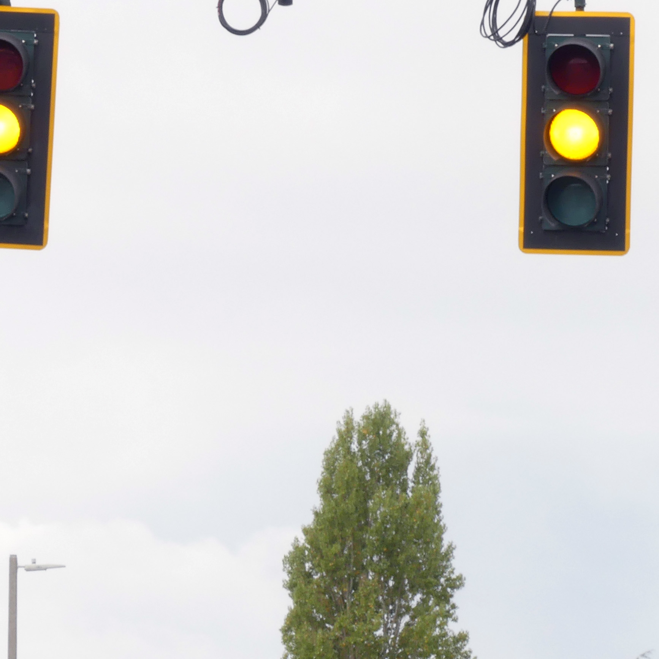
Most of us in Washington agree that any number of deaths on our roadways is unacceptable.*
This is how drivers do it in ________ County:
Caring for pedestrians by slowing down and stopping at yellow lights.
*2019 WTSC Positive Norms Survey Report

Slide 3
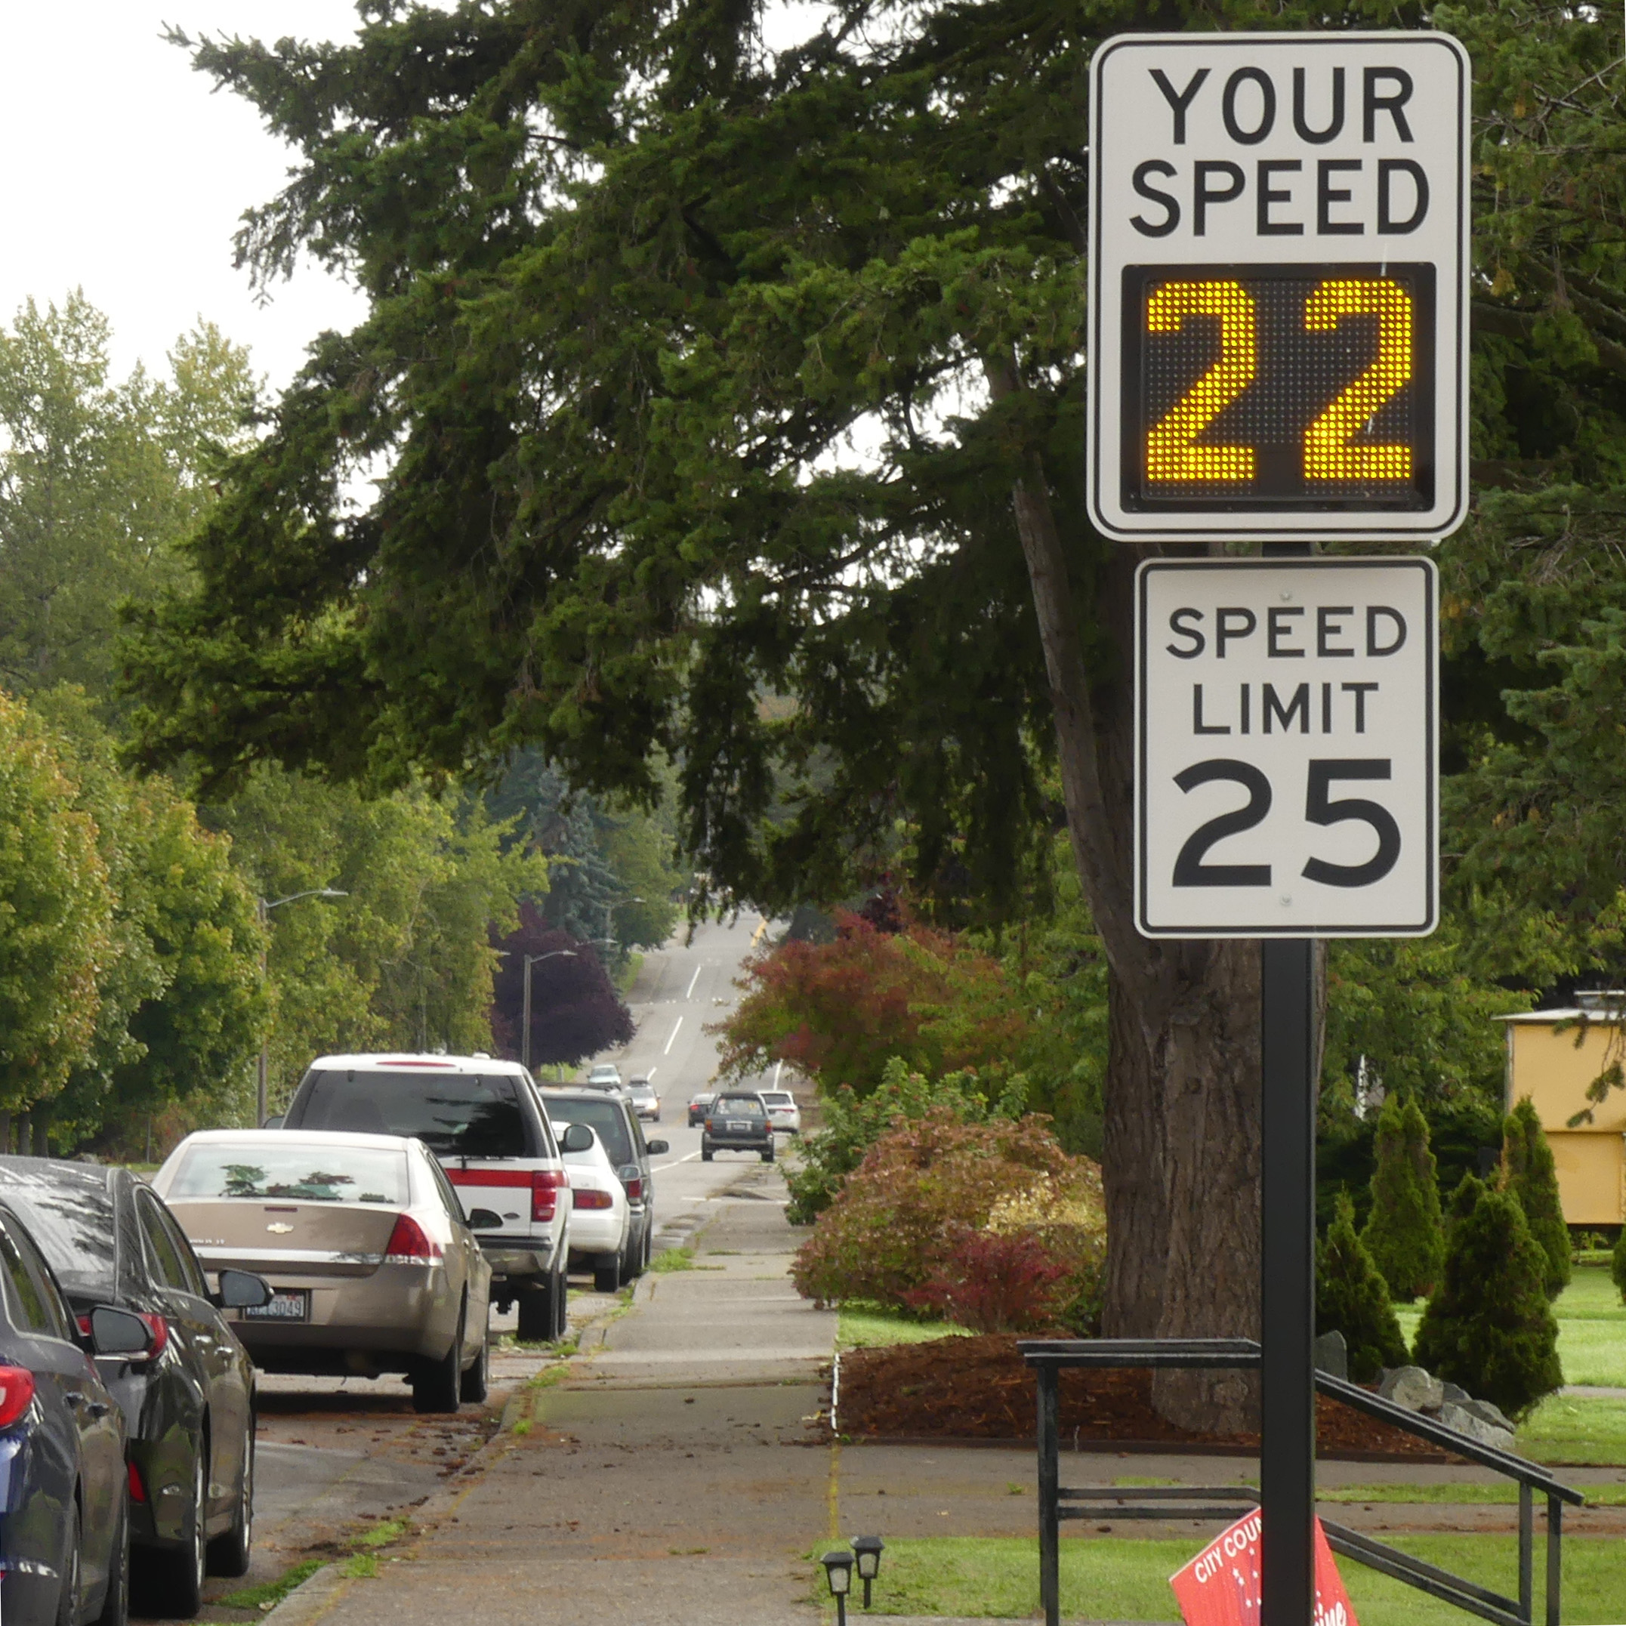
Most of us in Washington agree that we all share responsibility for the safety of others on our roads.*
This is how drivers do it in ________ County:
Respecting the speed limit: When you’re the biggest and the fastest, you also have to be the safest.
*2019 WTSC Positive Norms Survey Report

