Slide 1
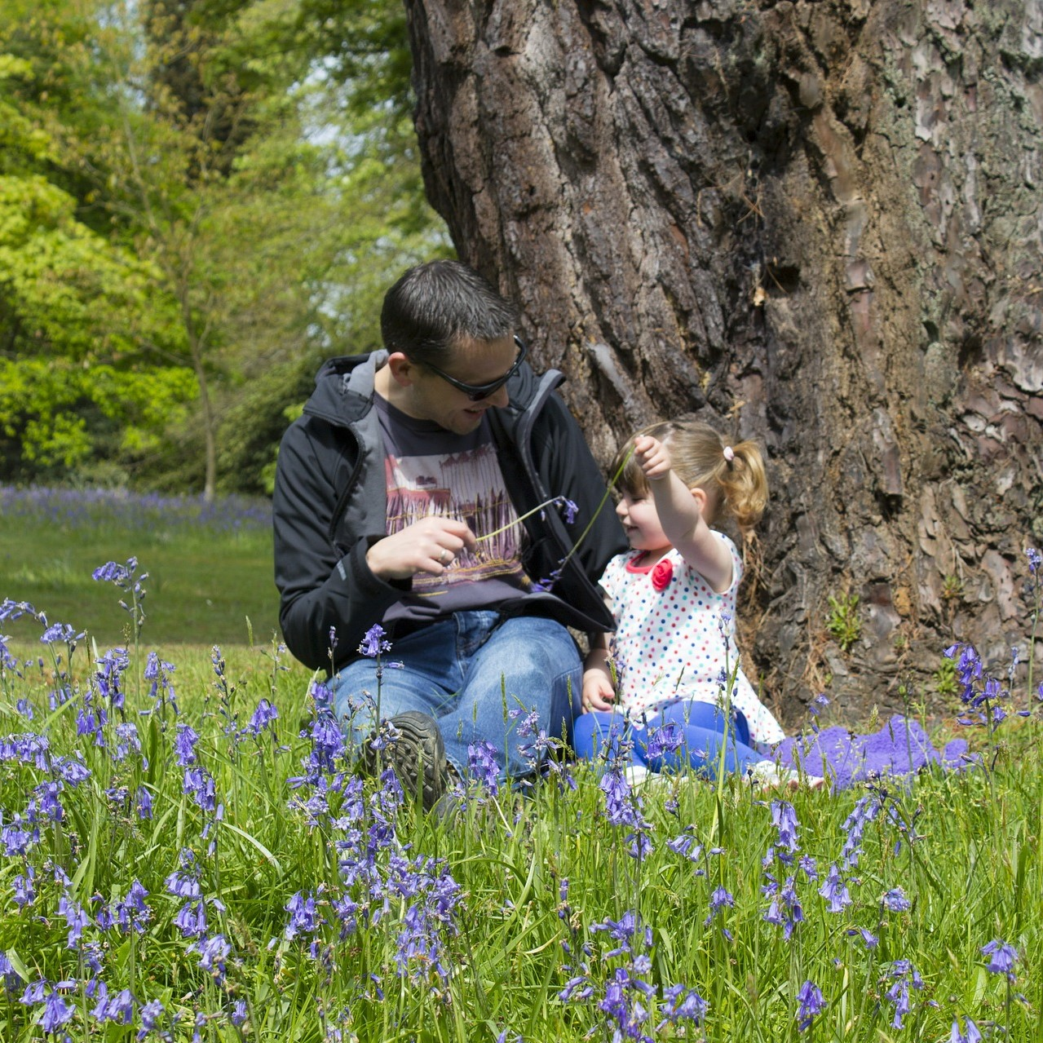

Dave R. – Dad to Emily, grocery store manager, rides his bike through Shoreline to get to work.
This is what a cyclist looks like:
Watching
for cyclists is watching out for your neighbors.
Notes:
Format for top right text:
First name, last initial
A relationship
A job, activity or hobby that the person participates in
A route that the person rides bike on

Slide 2
This is what a cyclist looks like:
Dave R. – Dad to Emily, grocery store manager, rides his bike through Shoreline to get to work.
Watching for cyclists is watching out for your neighbors.
Notes:
Format for top right text:
First name, last initial
A relationship
A job, activity or hobby that the person participates in
A route that the person rides bike on

