Slide 1
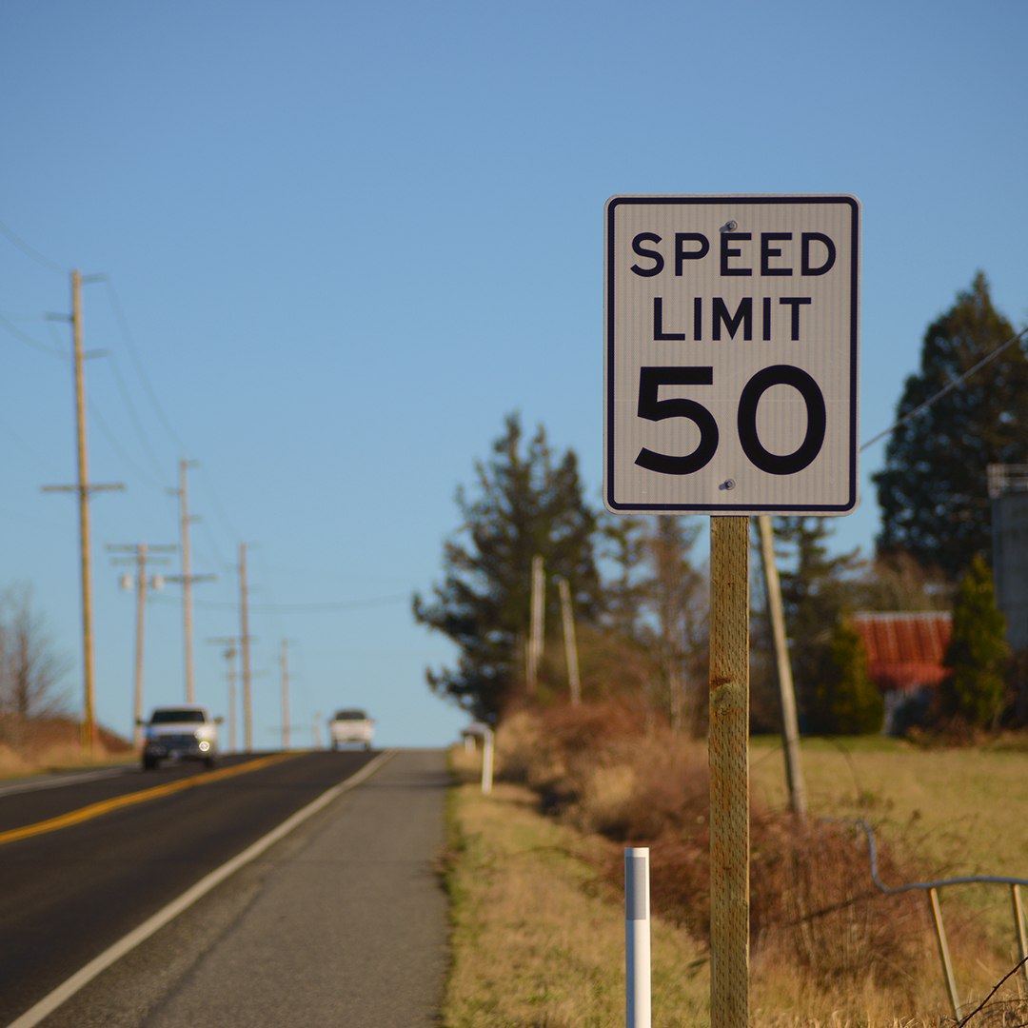

Most Whatcom County drivers
respect the speed limit.
For example, on Interstate 5 between Ferndale and Bellingham, 83 percent* of drivers travel within five mph of the speed limit or slower.
*Washington State Department of Transportation Speed Report – 4th Quarter 2019

Slide 2
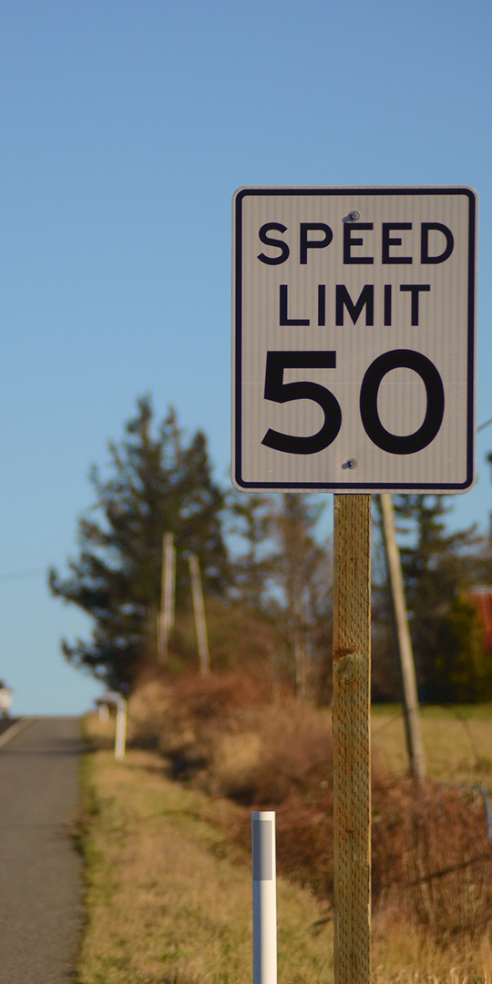
Most Chelan County drivers respect the speed limit.
For example, on Highway 2 in Cashmere, 80 percent* of drivers travel within five mph of the speed limit or slower.
*Washington State Department of Transportation Speed Report – 4th Quarter 2019

Slide 3
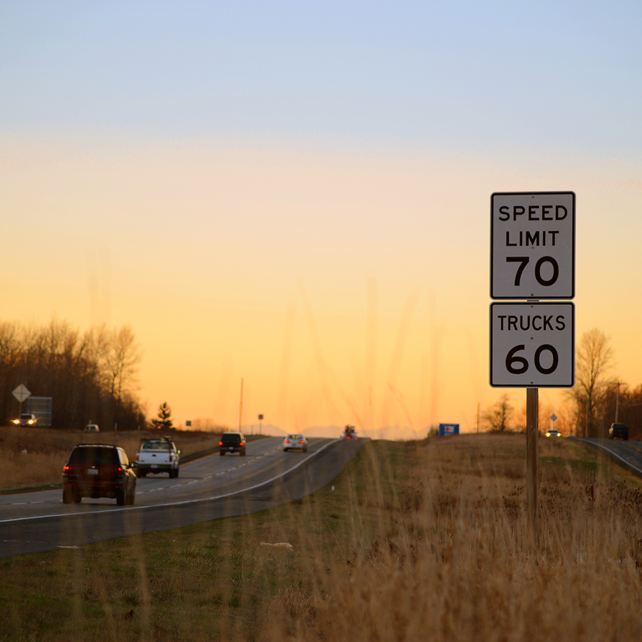
Most Benton County drivers
respect the speed limit.
For example, on Highway 395 near Kennewick, 91 percent* of drivers travel within five mph of the speed limit or slower.
*Washington State Department of Transportation Speed Report – 4th Quarter 2019

Slide 4
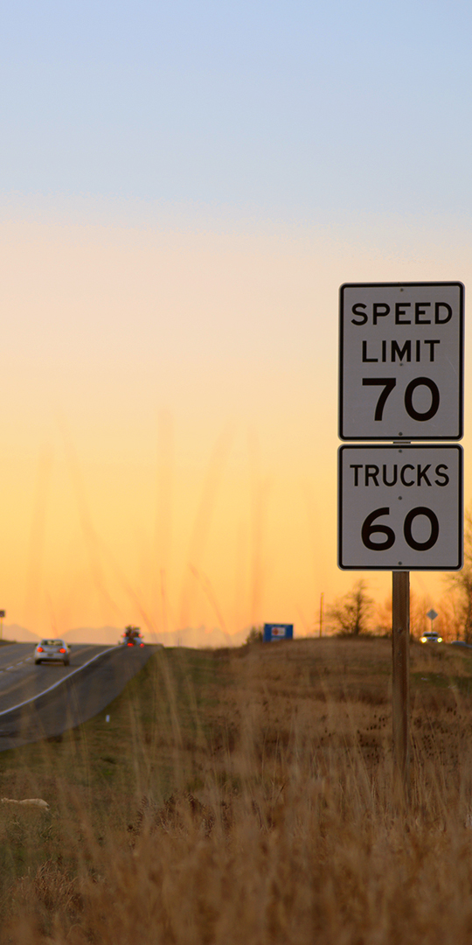
Most Adams County drivers respect the speed limit.
For example, on Highway near Othello, 83 percent* of drivers travel within five mph of the speed limit or slower.
*Washington State Department of Transportation Speed Report – 4th Quarter 2019

Slide 5
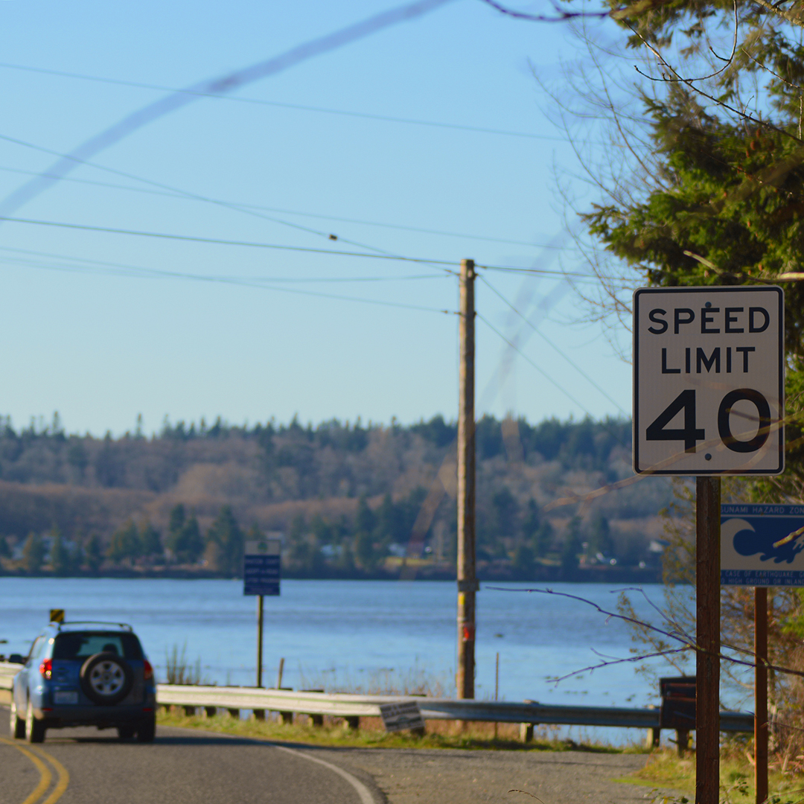
Most Kittitas County drivers
respect the speed limit.
For example, on Interstate 90 near Cle Elum, 88 percent* of drivers travel within five mph of the speed limit or slower.
*Washington State Department of Transportation Speed Report – 4th Quarter 2019

Slide 6
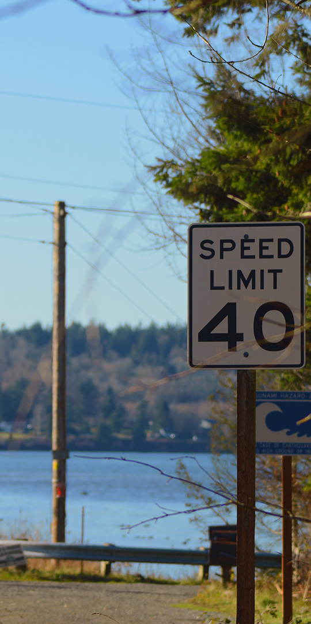
Most Whatcom County drivers respect the speed limit.
For example, on Interstate 5 between Ferndale and Bellingham, 83 percent* of drivers travel within five mph of the speed limit or slower.
*Washington State Department of Transportation Speed Report – 4th Quarter 2019

Slide 7
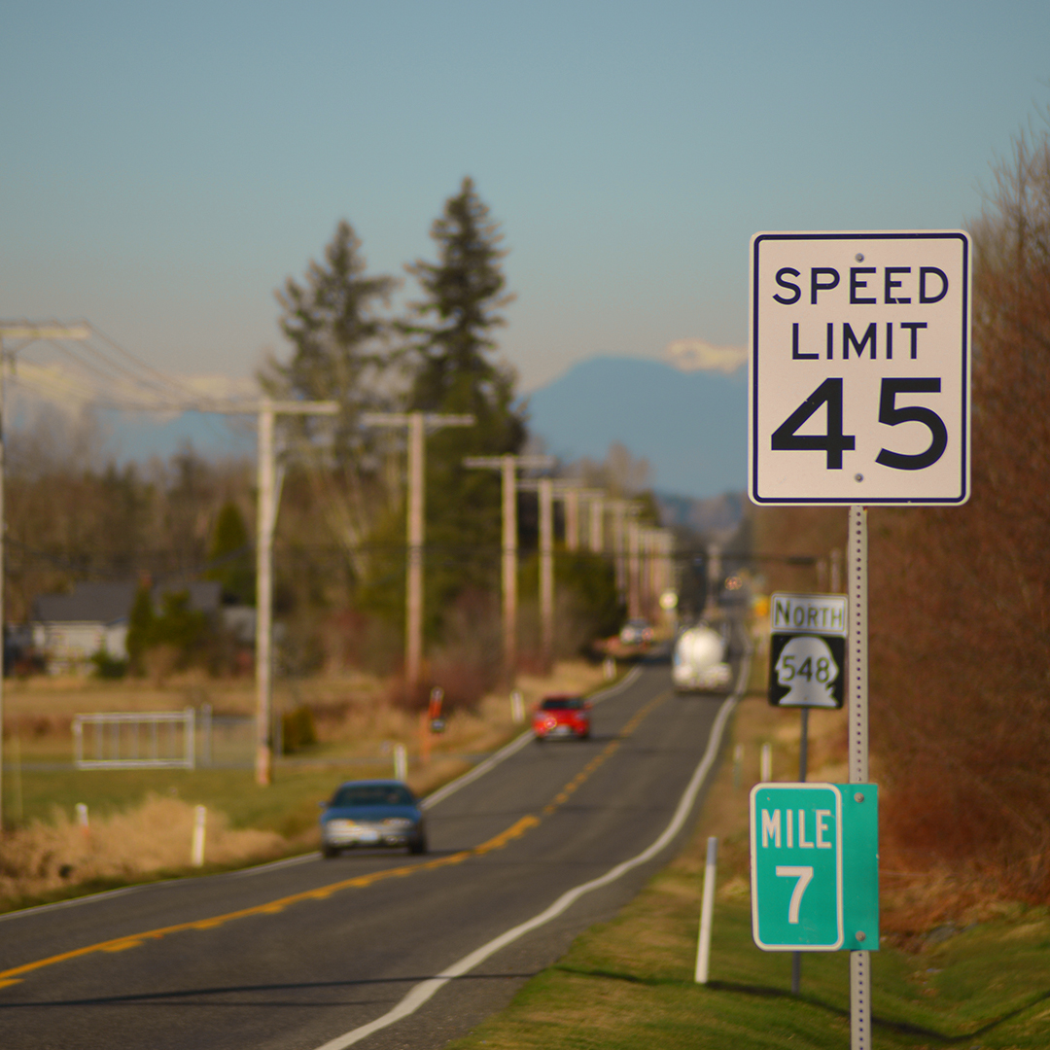
Most Whatcom County drivers
respect the speed limit.
For example, on Interstate 5 between Ferndale and Bellingham, 83 percent* of drivers travel within five mph of the speed limit or slower.
*Washington State Department of Transportation Speed Report – 4th Quarter 2019

Slide 8
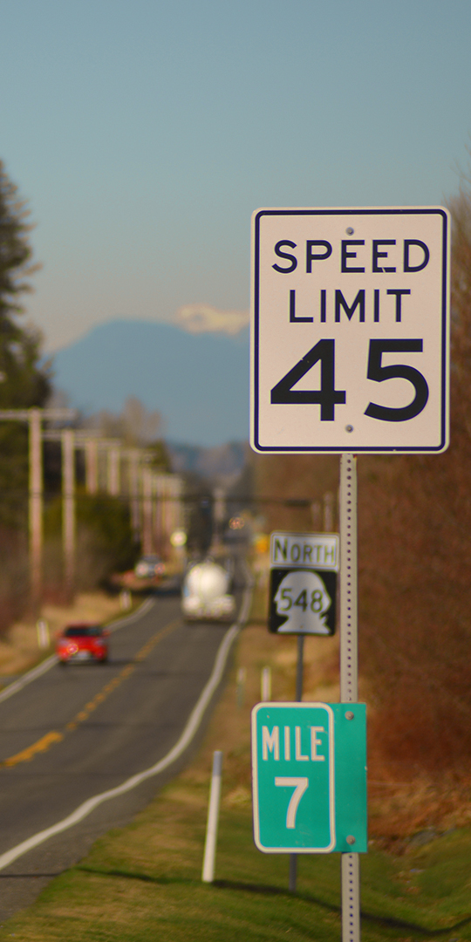
Most Whatcom County drivers respect the speed limit.
For example, on Interstate 5 between Ferndale and Bellingham, 83 percent* of drivers travel within five mph of the speed limit or slower.
*Washington State Department of Transportation Speed Report – 4th Quarter 2019

